Slide 1


O’REAL

Slide 2
We are Dream Killers…....
Savani De Silva
Vanodhya Oshadhi
Sanduni Fernando
Chanodya Welikala
Sanushka Amani
Lakshana Vadivalagan

Slide 3

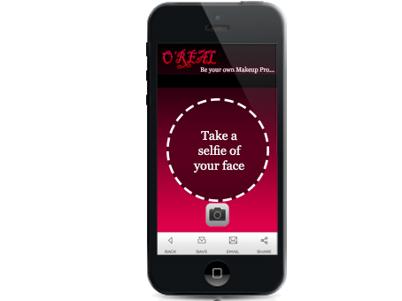
Content
Problem
Solution
Price
Promotion
Analysis on Company
Segmentation

Slide 4
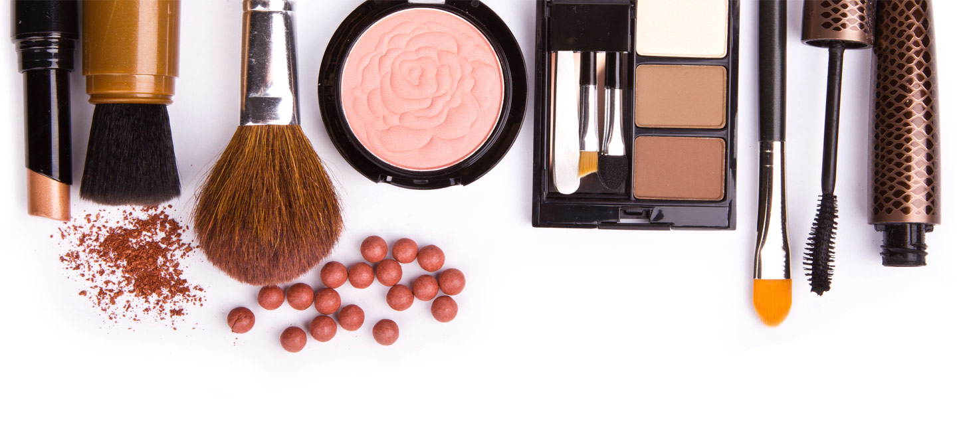
Problem
Lack of knowledge in self-make up
Waste of lots of money on beauticians
Having no idea about the skin tone
Having no proper make up guidance
Inability of matching colours

Slide 5
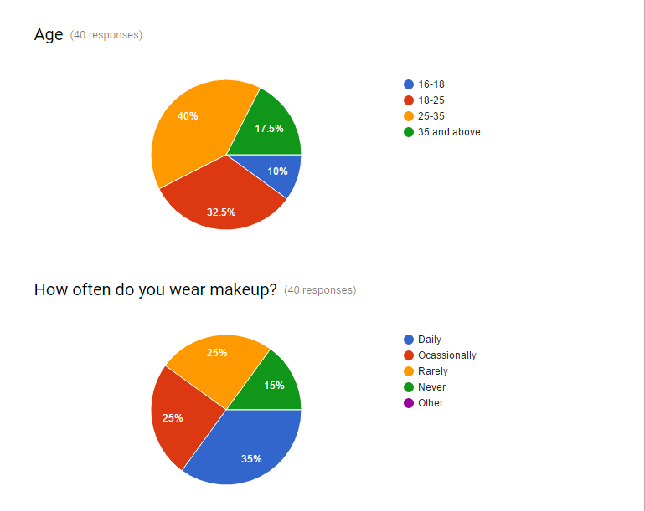
The Research we conducted…

Slide 6
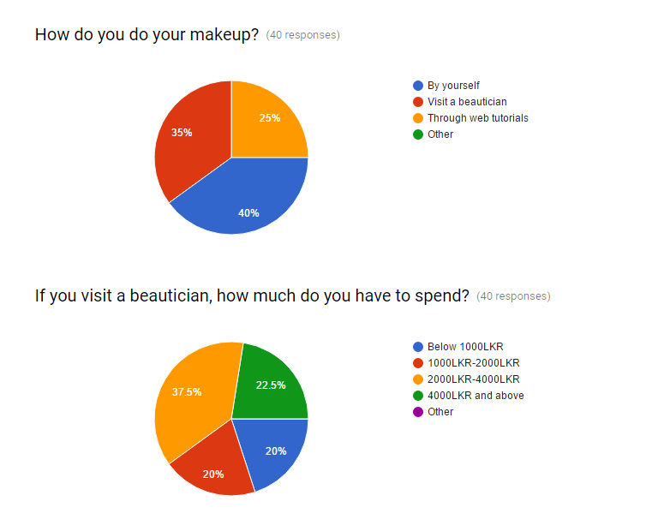

Slide 7
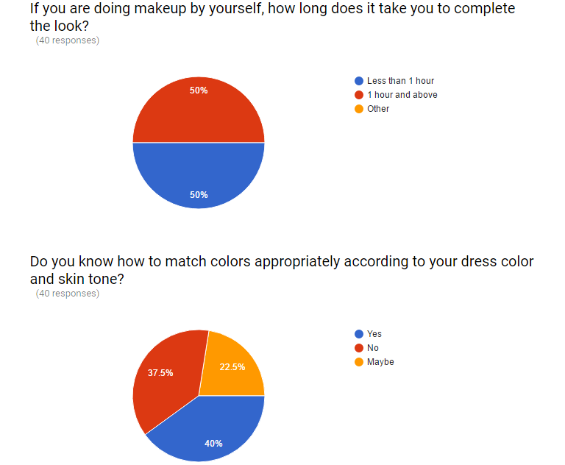

Slide 8
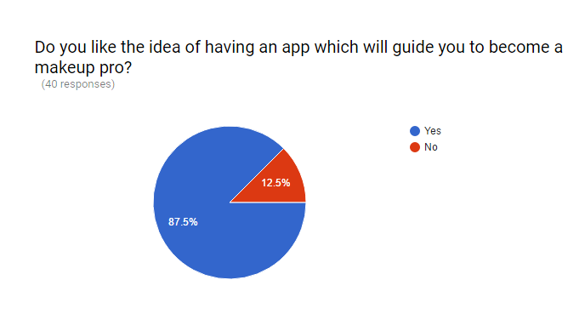

Slide 9

Analyzing the Competitors

Slide 10
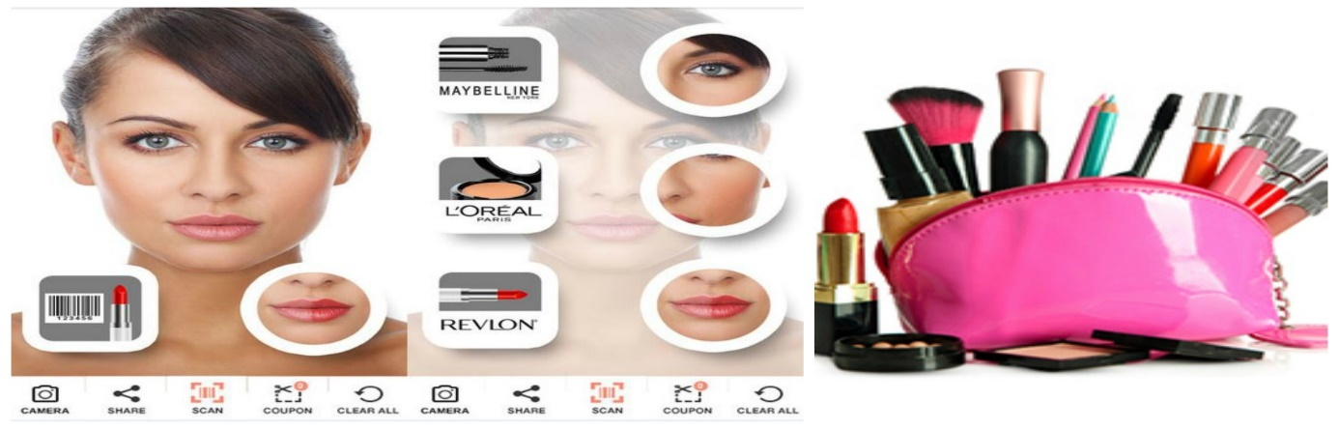
Solution
O’REAL – Website of make up guidance
Guidance to self makeup
Ability to find the correct skin tone
Match the makeup according to the occasion.
Guidance to match the colours with the skin tone
No more fear of following wrong makeup tips.
User friendly
Can be accessed with any browser

Slide 11
Price
7 days free trial
Penetration pricing strategy

Slide 12
Promotion
Online media – (Facebook/Twitter/Youtube)
Print media
Magazine
Tabloid
Sponsorships
Beauty pageants
Fashion shows

Slide 13
SWOT Analysis
Strength Low cost leader Unique functions Registered with the brands All brands in one place | Weakness Technical barriers Privacy concerns
Opportunities New Technologies emerging Decreasing unemployment Wider Target Market | Threats Easily imitate the idea Competitors are increasing

Slide 14
Segmentation
Office women
Teenage girls
Models

Slide 15
Market segmentation
Geographic's :
Immediate target audience is ladies who are fashion conscious
Demographics :
Age: Above 16
Gender : Females
Income level: Medium to high
Behavioural Factors
Fashion conscious people

Slide 16
Key to success
Add more features in future.
Provide with more real experience.
Trained employers

Slide 17
Coming Soon….
THE END

